Slide 1
Content-based recommendation
3.0
Content-based recommendation
3.1
Architecture of content-based systems, Content representation and content similarity, Item profiles, Discovering features of documents, Obtaining item features from tags, Representing item profiles, Methods for learning user profiles, Similarity based retrieval, The Role of User Generated Content in the Recommendation Process.
3.2
Bayes classifier for recommendation, Regression based recommendation system. Advantages and drawbacks of content-based filtering

Slide 2
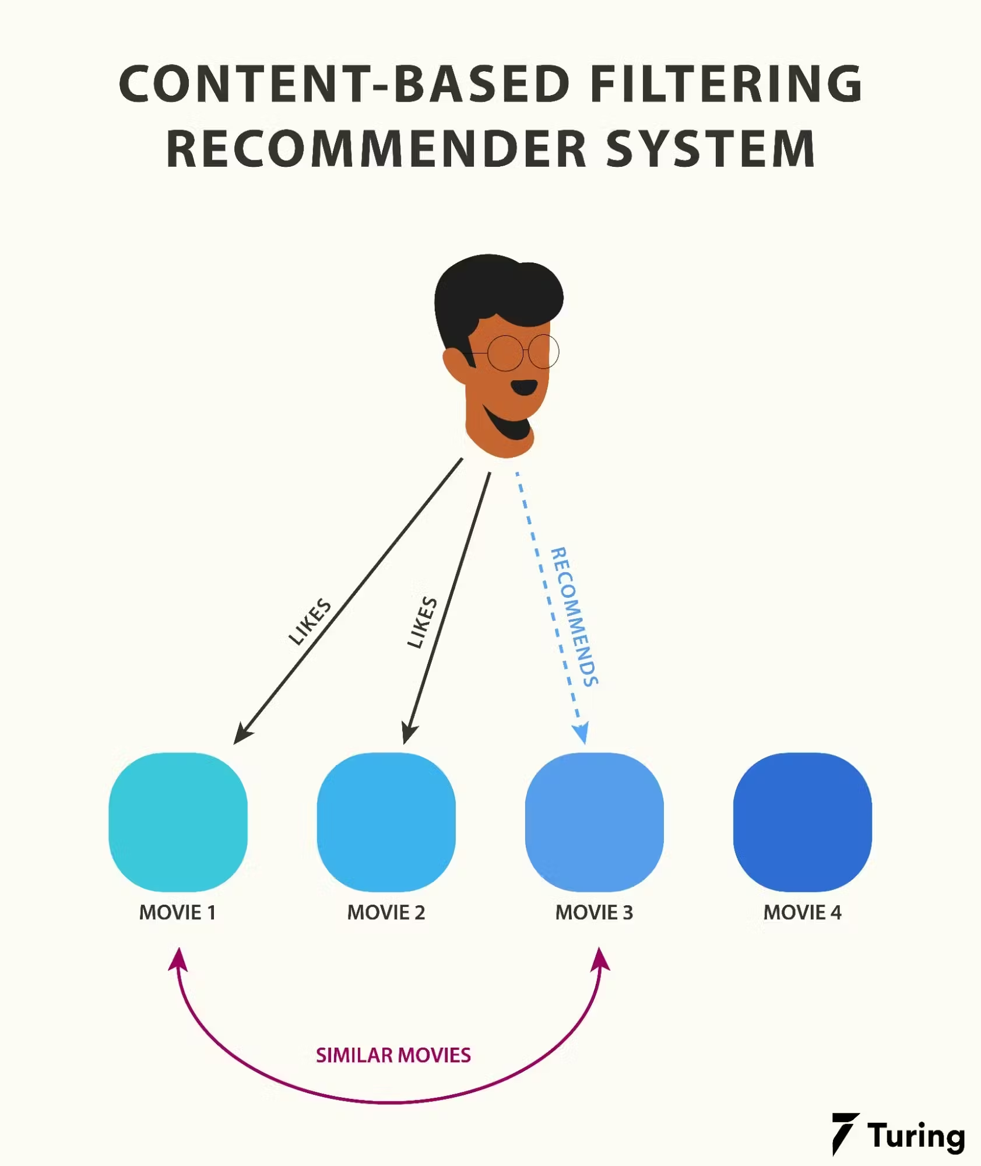

Slide 3
The basic process performed by a content-based recommender consists in matching up the attributes of a user profile in which preferences and interests are stored, with the attributes of a content object (item), in order to recommend to the user new interesting items.

Slide 4
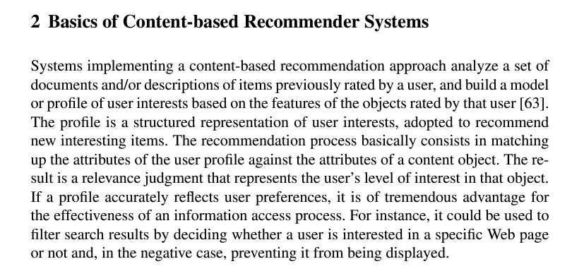

Slide 5
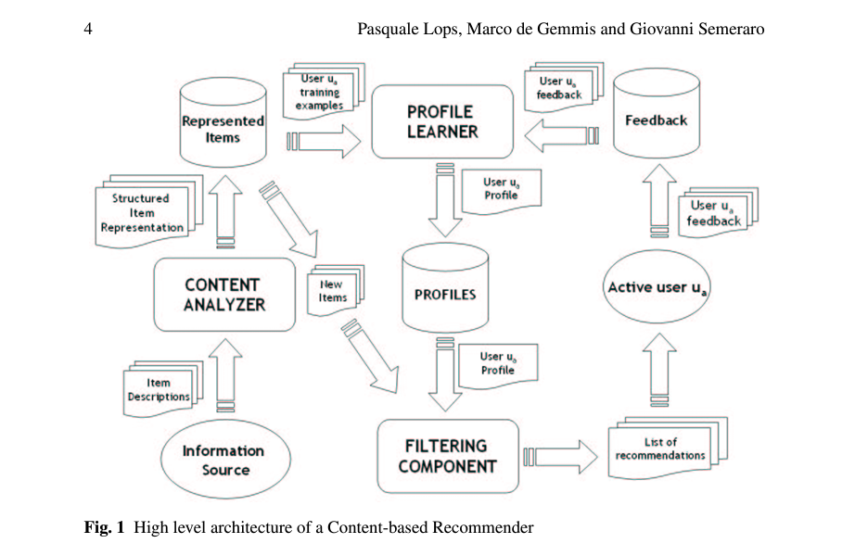

Slide 6
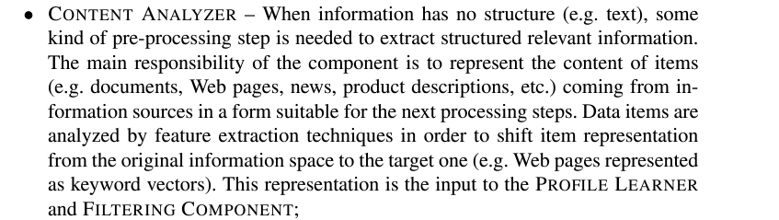
Item descriptions coming from InformationSource are processed by the CONTENT ANALYZER,that extracts features(keywords,n-grams,concepts,...) from unstructured text to produce a structured item representation, stored in the repository Represented Items.
Borrows techniques from Information Retrieval systems

Slide 7
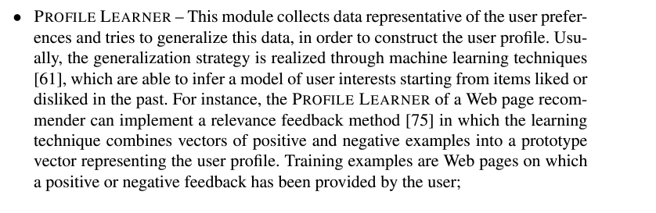
ratings
Text comments
like/dislike
Explicit feedback
Implicit feedback

Slide 8
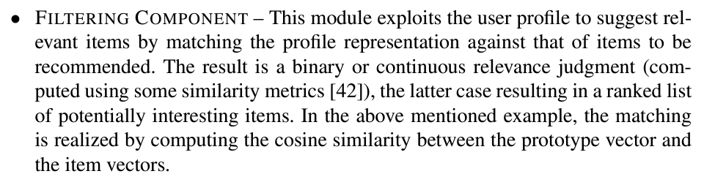

Slide 9
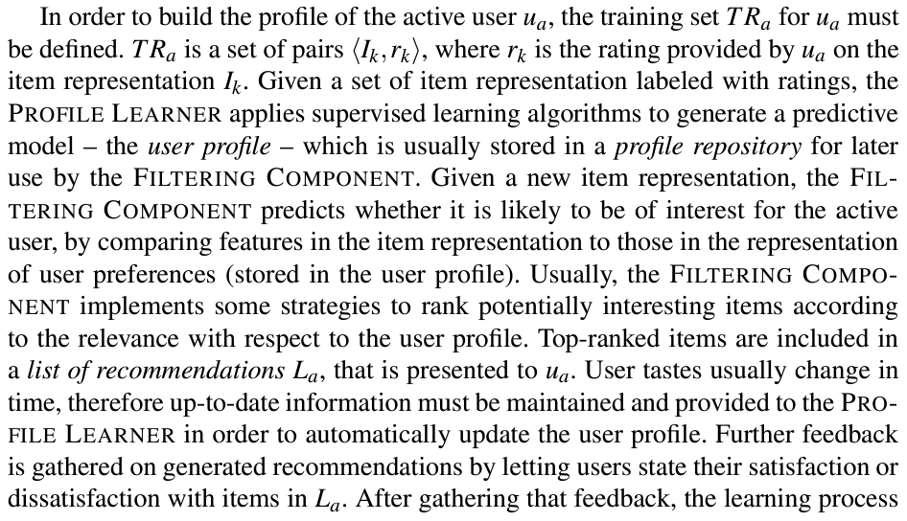

Slide 10
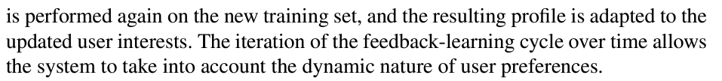

Slide 11
Applications of Recommendation Systems
Product Recommendations
Movie Recommendations
News Articles

Slide 12
Models for recommendation systems

Slide 13
The Utility Matrix
The data itself is represented as a utility matrix, giving for each user-item pair,a value that represents what is known about the degree of preference of that user for that item.Values come from an ordered set, e.g., integers 1–5 representing the number of stars that the user gave as a rating for that item. We assume that the matrix is sparse,meaning that most entries are“unknown.”An unknown rating implies that we have no explicit information about the user's preference for the item.

Slide 14
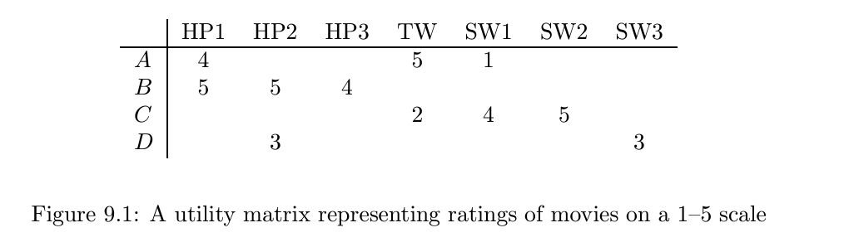

Slide 15
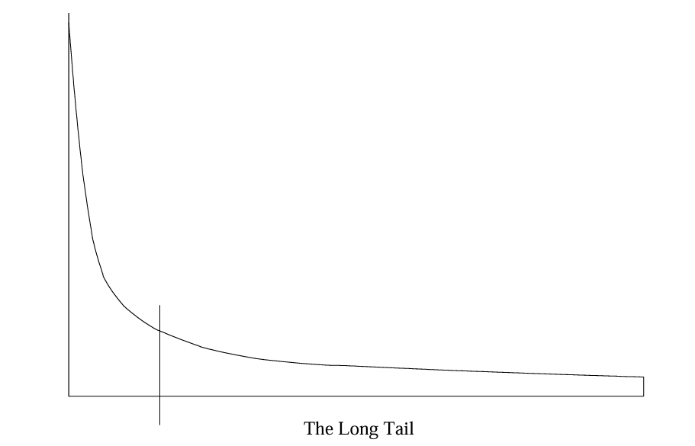
Long Tail

Slide 16
Populating the Utility Matrix
Ask users to submit online rating
We can make inferences from users behavior. Most Obviously, if a user buys a product at Amazon,watches a movie on YouTube,or reads a news article, then the user can be said to “like” this item.Note that this sort of rating system really has only one value: 1 means that the user likes the item.

Slide 17
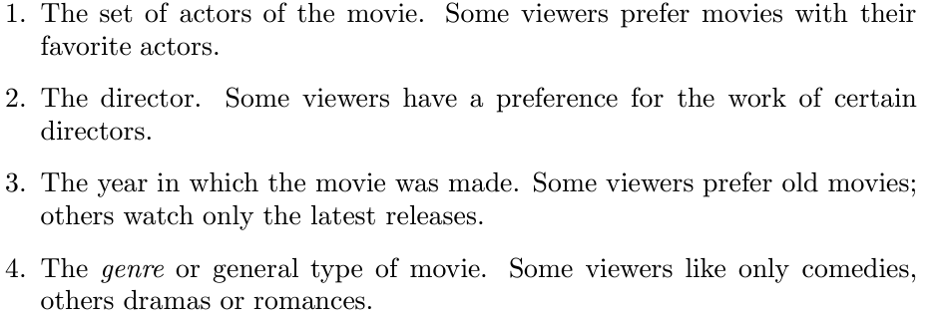
Item profile
In a content-based system,we must construct for each item profile, which is a record or collection of records representing important characteristics of that item.
Eg the features of a movie

Slide 18
Discovering Features of Documents
There are many kinds of documents for which a recommendation system can be useful.
For example,
there are many news articles published each day,and we can not read all of them.A recommendation system can suggest articles on topics a user is interested in
Web pages are also a collection of documents

Slide 19
Steps
Remove stop words
For the remaining words,compute the TF.IDF score for each word in the document. Theoneswiththehighest scoresarethewords that characterize the document.
We may then take as the features of document then words with the highest TF.IDF scores. It is possible to pick “n” to be the same for all documents,or to let n be a fixed percentage of the words in the document.We could so choose to make all words whose TF.IDF scores are above given threshold to be a part of the featureset
To Measure The Similarity Of Two documents, there are several natural distance measures we can use : Jaccard distance or cosine distance

Slide 20
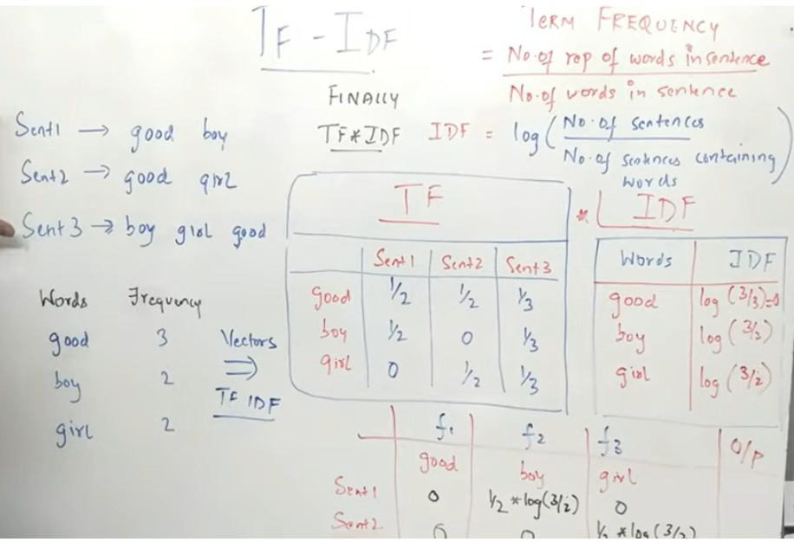

Slide 21
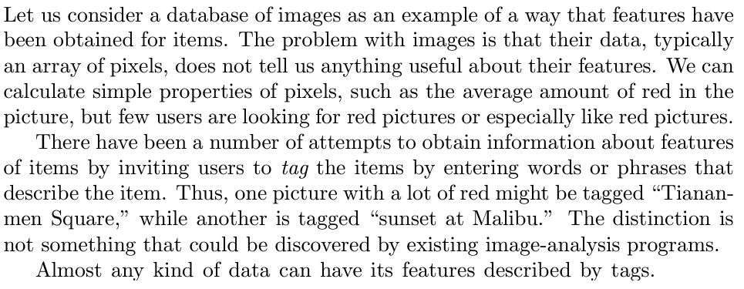
Obtaining Item Features From Tags
Problem is user should be able willing to tag

Slide 22
Representing Item Profiles
Sometime features are added as 1 or 0 (like or dislike ) sometime numerical values are used (ratings)
There is no harm if some components of the vectors are Boolean and others are real-valued or integer-valued.
We can still compute the cosine distance between vectors, although if we do so, we should give some thought to the appropriate scaling of the non Boolean components, so that they neither dominate the calculation nor are they irrelevant.

Slide 23
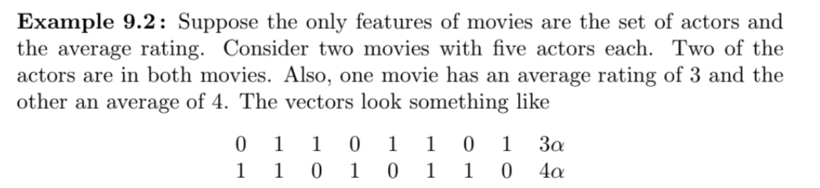

Slide 24

α = 1,
0.816.

Slide 25
Learning User Profiles and Filtering
We assume that we have a set D_{L} of training documents, which are labeled by a specific user. Furthermore, the training data contain the ratings assigned by the active user to these documents. These documents are used to construct a training model.
The labels on the documents correspond to the numeric, binary, or unary ratings.
Assume that the i^{th} document in D_{L} has a rating denoted by c_{i}. We also have a set D_{U} of testing documents, which are unlabeled. Note that both D_{L} and D_{U} are specific to a particular (active) user

Slide 26
D_{U} might correspond to candidate Web documents for recommendation to the active user. The precise definition of D_{U} depends on the domain at hand, but the individual documents in D_{U} are extracted in a similar way to those in D_{L}. The training model on D_{L} is used to make recommendations from D_{U} to the active user.
Problem is of classification or regression.

Slide 27
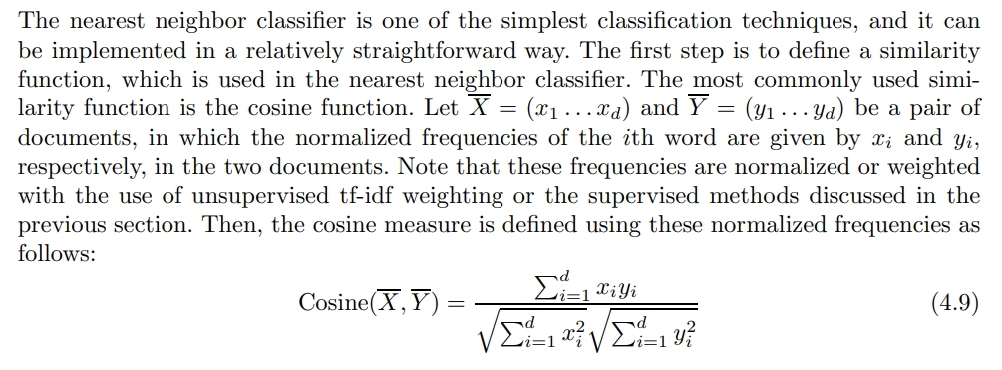
Nearest Neighbor Classification

Slide 28
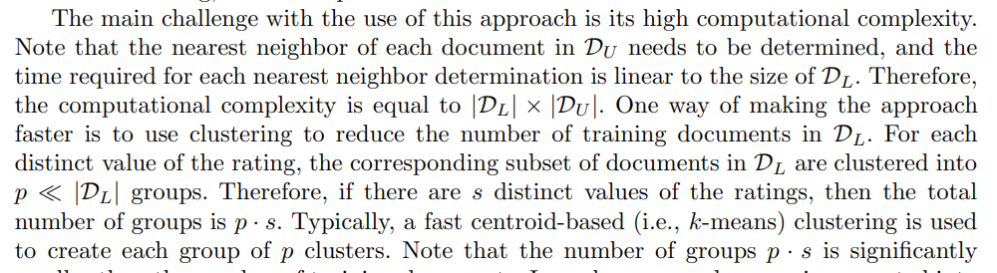
For each document in D_{U} , its k-nearest neighbors in D_{L} are determined using the cosine similarity function. The average value of the rating for the k neighbors of each item in D_{U} is determined. This average value is the predicted rating for the corresponding item in D_{U} . An additional heuristic enhancement is that one can weight each rating with the similarity value.
small

Slide 29
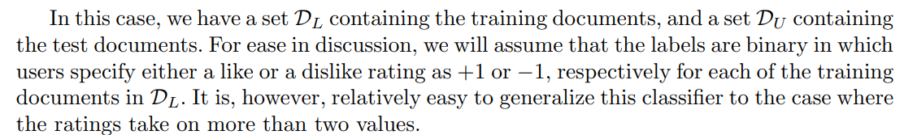
Bayes Classifier

Slide 30
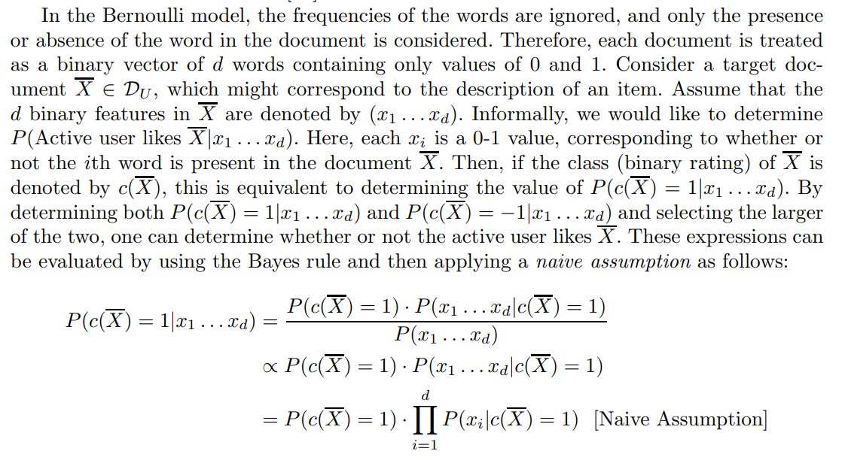

Slide 31
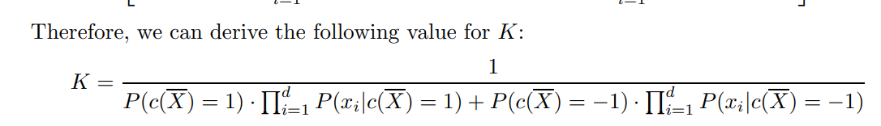
The naive assumption states that the occurrences of words in documents are conditionally independent events (on a specific class), and therefore one can replace P(x1 ...xd|c(X) = 1) with d i=1 P(xi|c(X) = 1).
In cases where such a ranking of the items is needed, the constant of proportionality is no longer irrelevant. This is particularly common in recommendation applications where it is not sufficient to determine the relative probabilities of items belonging to different rating values, but to actually rank them with respect to one another. In such cases, the constant of proportionality needs to be determined. Assume that the constant of proportionality in the relationship above is denoted by K

Slide 32
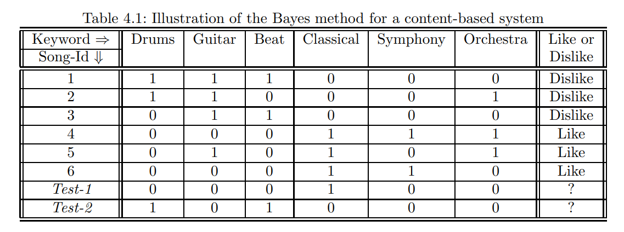

Slide 33
Rule-based Classifiers
Rule-based classifiers in content-based systems are similar to rule-based classifiers in collaborative filtering. In the item-item rules of collaborative filtering, both the antecedents and consequents of rules correspond to ratings of items. The main difference is that the antecedents of the rules in collaborative filtering correspond to the ratings of various items,
Item contains keyword set A ⇒ Rating= Like
Item contains keyword set B ⇒ Rating=Dislike

Slide 34
The first step is to leverage the active user profile (i.e., training documents) to mine all the rules at a desired level of support and confidence. As in all content-based methods, the rules are specific to the active user at hand. For example, in the case of Table 4.1, the active user seems to be interested in classical music. In this case, an example of a relevant rule, which has 33% support and 100% confidence, is as follows:
{Classical, Symphony} ⇒ Like

Slide 35
overall approach for rule-based classification can be described as follows:
1. (Training phase:) Determine all the relevant rules from the user profile at the desired level of minimum support and confidence from the training data set DL.
2. (Testing phase) For each item description in DU , determine the fired rules and an average rating. Rank the items in DU on the basis of this average rating

Slide 36
Rule 1: {Classical} ⇒ Like (50%, 100%)
Rule 2: {Symphony} ⇒ Like (33%, 100%)
Rule 3: {Classical, Symphony} ⇒ Like (33%, 100%)
Rule 4: {Drums, Guitar} ⇒ Dislike (33%, 100%)
Rule 5: {Drums} ⇒ Dislike (33%, 100%)
Rule 6: {Beat} ⇒ Dislike (33%, 100%)
Rule 7: {Guitar} ⇒ Dislike (50%, 75%)

Slide 37
It is evident that rule 2 is fired by Test-1, whereas rules 5 and 6 are fired by Test-2. Therefore, Test-1 should be preferred over Test-2 as a recommendation to the active user. Note that the rules fired by Test-1 also provide an understanding of why it should be considered the best recommendation for the active user.

Slide 38
Regression-Based Models
Regression-based models have the merit that they can be used for various types of ratings such as binary ratings, interval-based ratings, or numerical ratings. Large classes of regression models such as linear models, logistic regression models, and ordered probit models can be used to model various types of ratings. Here, we will describe the simplest model, which is referred to as linear regression

Slide 39
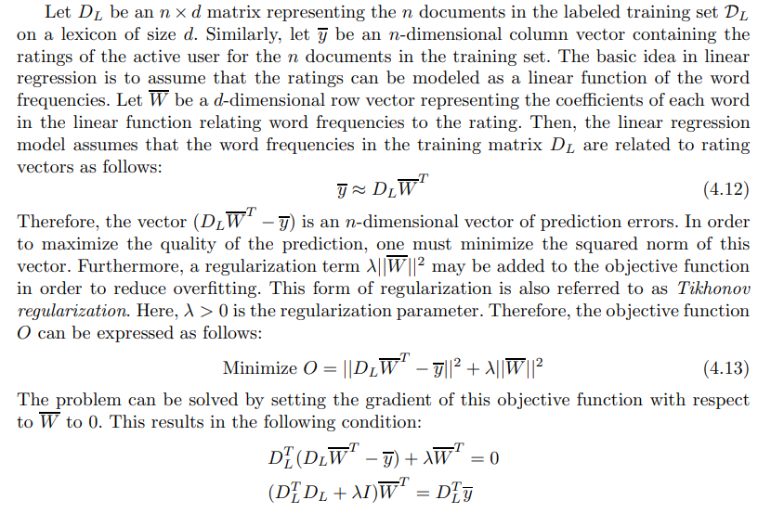

Slide 40
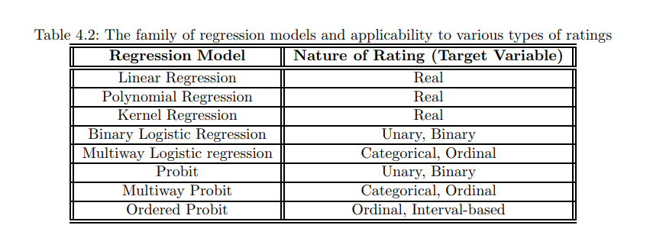

Slide 41
Advantages
It is noteworthy that the ratings of the other users usually play no role in a content-based recommendation algorithm.
This is both an advantage and a disadvantage, depending on the scenario at hand. On the one hand, in cold-start scenarios, where little information about the ratings of other users is available, such an approach can still be used as long as sufficient information about the user’s own interests are available. This, at least, partially alleviates the cold-start problem when the number of other users in the recommender system is small. Furthermore, when an item is new, it is not possible to obtain the ratings of other users for that item. Content-based methods enable recommendations in such settings because they can extract the attributes from the new item, and use them to make predictions

Slide 42
Disadvantages
On the other hand, the cold-start problem for new users cannot be addressed with content-based recommender systems.
Furthermore, by not using the ratings of other users, one reduces the diversity and novelty of the recommended items. In many cases, the recommended items may be obvious items for the user, or they may be other items that the user has consumed before. This is because the content attributes will always recommend items with similar attributes to what the user has seen in the past

Slide 43
Informing Recommendation Algorithms: UGC provides valuable data points that recommendation algorithms can analyze to understand user preferences and behaviors. By incorporating user reviews, ratings, comments, and interactions, recommendation systems can better tailor their suggestions to individual users' tastes and needs.
Enhancing Personalization: UGC enriches the personalization capabilities of recommendation systems by offering insights into users' diverse interests and preferences. By leveraging UGC, recommendation algorithms can deliver more relevant and targeted recommendations, increasing user satisfaction and engagement.
Building Trust and Credibility: User-generated reviews and recommendations carry significant weight in building trust and credibility. Consumers often rely on the experiences and opinions of their peers when making purchasing decisions. By showcasing UGC, recommendation systems can instill confidence in their suggestions and encourage users to explore recommended content or products.
Diversifying Recommendations: UGC helps recommendation systems avoid homogeneity by diversifying the range of content and products suggested to users. By considering a broader spectrum of user-generated feedback, recommendation algorithms can offer more varied and inclusive recommendations, catering to the diverse preferences of their user base.
Enabling Social Influence: UGC facilitates social influence within recommendation systems. Users are influenced by the preferences and behaviors of their peers, making user-generated reviews, ratings, and recommendations powerful drivers of decision-making. Recommendation systems leverage this social influence to guide users towards content or products that align with popular sentiment or peer endorsement.
Feedback Loop for Improvement: User-generated feedback serves as a feedback loop for recommendation systems, enabling continuous improvement and refinement. By analyzing UGC data, recommendation algorithms can identify patterns, trends, and areas for enhancement. This iterative process ensures that recommendation systems evolve to better meet user needs and preferences over time.
Fostering Community Engagement: UGC fosters a sense of community and belonging within recommendation systems. Users can engage with each other through comments, discussions, and interactions around recommended content or products. This sense of community encourages user participation, generates valuable UGC, and enhances the overall user experience.

Slide 44
Introduction
The ratings of other users may not be required to make meaningful recommendations
Content-based recommender systems try to match users to items that are similar to what they have liked in the past. This similarity is not necessarily based on rating correlations across users but on the basis of the attributes of the objects liked by the user.
Unlike collaborative systems, which explicitly leverage the ratings of other users in addition to that of the target user, content-based systems largely focus on the target user’s own ratings and the attributes of the items liked by the user

Slide 45
At the most basic level, content-based systems are dependent on two sources of data:
1. The first source of data is a description of various items in terms of content-centric attributes. An example of such a representation could be the text description of an item by the manufacturer.
2. The second source of data is a user profile, which is generated from user feedback about various items. The user feedback might be explicit or implicit. Explicit feedback may correspond to ratings, whereas implicit feedback may correspond to user actions. The ratings are collected in a way similar to collaborative systems.

Slide 46
Uses of content based systems
Content-based systems are largely used in scenarios in which a significant amount of attribute information is available at hand. In many cases, these attributes are keywords, which are extracted from the product descriptions. In fact, the vast majority of contentbased systems extract text attributes from the underlying objects. Content-based systems are, therefore, particularly well suited to giving recommendations in text-rich and unstructured domains. A classical example of the use of such systems is in the recommendation of Web pages.
Content-based systems are closely related to knowledge-based recommender systems.

Slide 47
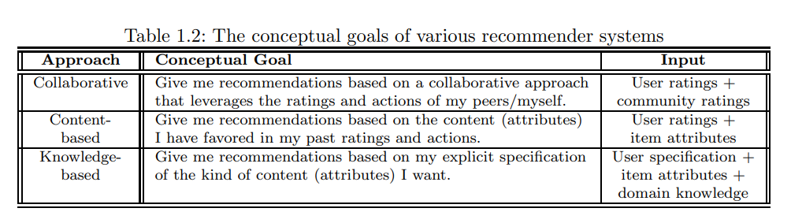

Slide 48
Basic Components of Content-Based Systems
preferred to convert the item descriptions into keywords
natural applications of content-based systems are also text-centric.
text classification and regression modeling methods remain the most widely used tools for creating content-based recommender systems.
(offline) preprocessing portion,
(offline) learning portion,
(online) prediction portion.

Slide 49
The various components of content-based systems are as follows:
1. Preprocessing and feature extraction:
2. Content-based learning of user profiles:
3. Filtering and recommendation:

Slide 50
Preprocessing and Feature Extraction
1.1 Feature Extraction
the descriptions of various items are extracted
the most common approach is to extract keywords from the underlying data
descriptions of the books and keywords describing the content, title, and author. In some cases, these descriptions can be converted into a bag of keywords
Feature weighting is closely related to feature selection, in that the former is a soft version of the latter. In the latter case, attributes are either included or not included depending on their relevance, whereas in the former case, features are given differential weight depending on their importance.

Slide 51
Example of Product Recommendation : IMDb rating
1. Domain-specific knowledge can be used to decide the relative importance of keywords. For example, the title of the movie and the primary actor may be given more weight than the words in the description. In many cases, this process is done in a heuristic way with trial and error.
2. In many cases, it may be possible to learn the relative importance of various features in an automated way. This process is referred to as feature weighting, which is closely related to feature selection. Both feature weighting and feature selection are described in a later section.

Slide 52
Example of Web Page Recommendation
Web documents require specialized preprocessing techniques because of some common properties of their structure and the richness of the links inside them. Two major aspects of Web document preprocessing include the removal of specific parts of the documents (e.g., tags) that are not useful and the leveraging of the actual structure of the document.
For example, the title of a document is considered more important than the body and is weighted more heavily
Anchor text contains a description of the Web page pointed to by a link. Because of its descriptive nature, it is considered important, but it is sometimes not relevant to the topic of the page itself. Therefore, it is often removed from the text of the document.
where possible, anchor text could even be added to the text of the document to which it points.
the structure of the layout is learned from the documents at the site by extracting tag trees from the site. Other main blocks are then extracted through the use of the tree-matching algorithm [

Slide 53
Example of Music Recommendation
The user feedback is used to build a more refined model for music recommendation
Pandora Internet radio

Slide 54
2 Feature Representation and Cleaning
There are several steps in the cleaning process:
1. Stop-word removal
2. Stemming
3. Phrase extraction
After executing these steps, the keywords are converted into a vector-space representation. Each word is also referred to as a term. In the vector-space representation, documents are represented as bags of words, together with their frequencies.
commonly occurring words are often statistically less discriminative
:such words are often discounted by down-weighting.
Soft

Slide 55
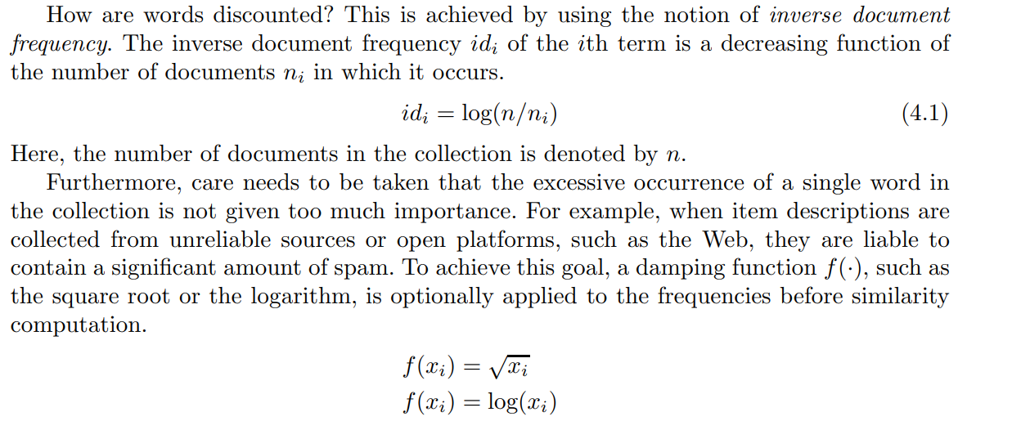
How are words discounted?
inverse document frequency

Slide 56
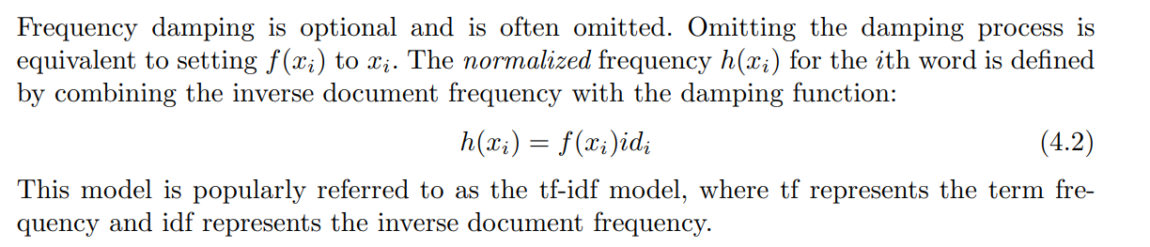

Slide 57
Collecting User Likes and Dislikes
Aside from the content about the items, it is also necessary to collect data about the user likes and dislikes for the recommendation process. The data collection is done during the offline phase, whereas recommendations are determined during the online phase when a specific user is interacting with the system.
The data about user likes and dislikes can take on any of the following forms
Rating
Implicit feedback
Text opinions
Cases

Slide 58
Supervised Feature Selection and Weighting
The goal of feature selection and weighting is to ensure that only the most informative words are retained in the vector-space representation.
The basic idea is that the noisy words often result in overfitting and should therefore be removed a priori. This is particularly important, considering the fact that the number of documents available to learn a particular user profile is often not very large. When the number of documents available for learning is small, the tendency of the model to overfit will be greater. Therefore, it is crucial to reduce the size of the feature space

Slide 59
One is feature selection, which corresponds to the removal of words. The second is feature weighting, which involves giving greater importance to words. Note that stop-word removal and the use of inverse-document frequency are examples of feature selection and weighting, respectively
However, these are unsupervised ways of feature selection and weighting, where user feedback is given no importance. In this section, we will study supervised methods for feature selection, which take the user ratings into account for evaluating feature informativeness.
Gini Index
Entropy
χ2-Statistic
Normalized Deviation
Feature Weighting

Slide 60
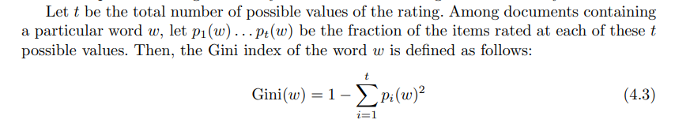
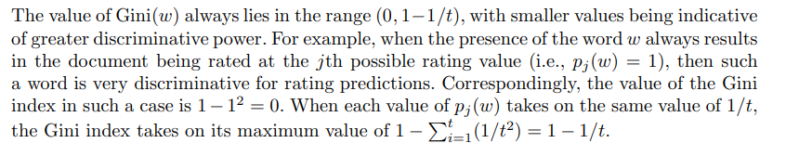
Gini index

Slide 61
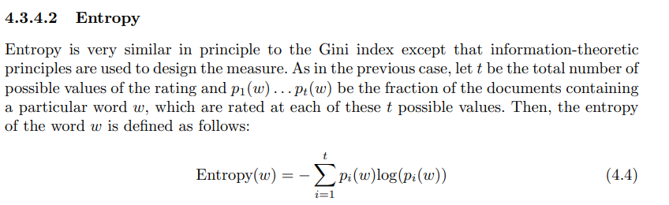
Same as Gini Index

